Slide 1
The effect of balancing methods on model behaviour in NLP imbalanced classification problems
Maciej Pawlikowski
Supervisors: Anna wróblewska, Daniel dan

Slide 2
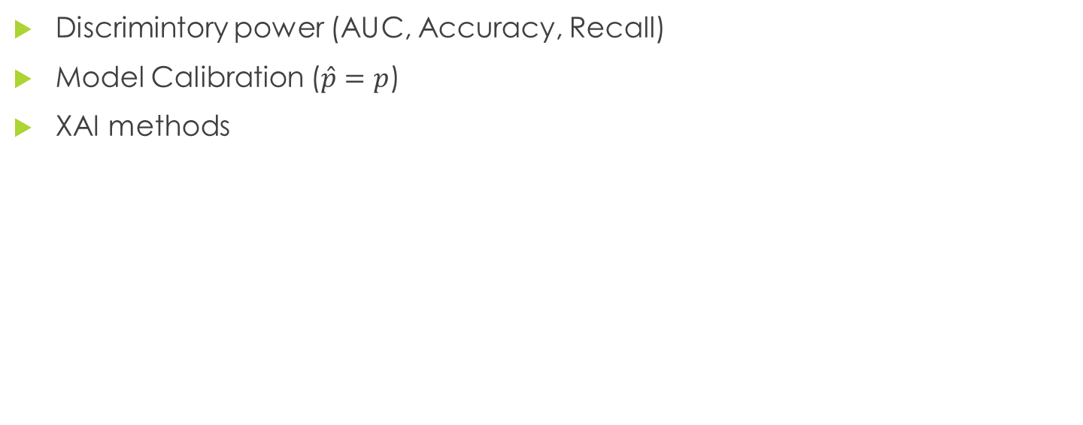
Project idea
Discrimintory power (AUC, Accuracy, Recall)
Model Calibration ($\hat{p}=p$)
XAI methods

Slide 3
Balancing methods
Oversampling
Undersampling
Class weights
[Henning et al., 2023] Henning, S., Beluch, W., Fraser, A., and Friedrich, A. (2023). A survey of methods for addressing class imbalance in deep-learning based natural language processing. In Vlachos, A. and Augenstein, I., editors, Proceedings of the 17th Conference of the European Chapter of the Association for Computational Linguistics, pages 523–540, Dubrovnik, Croatia. Association for Computational Linguistics.

Slide 4
Oversampling
Data augmentation
  Random Oversampling
  Transformer/LLM- based generation
  Synonym replacement
  Using translation
Hidden space augmentation
  SMOTE
Notes:
Show example
steps to implement the SMOTE algorithm:
Draw a random set from the minority class.
For all the observations for the sample, locate the K-nearest neighbors. To obtain the distance between the neighbors, find the Euclidean distance.
The next step is to find the vector between the current data point and the selected neighbor.
Next, multiply a vector between 0 and 1.
To obtain the new dataset, add new samples to the current data point.
In latetnt space

Slide 5
Models
Transformers:
  BERT
  RoBERTa
  ELECTRA
LLM:
  LLaMA
  GPT- 3.5
Notes:
ELECTRA (Efficiently Learning an Encoder that Classifies Token Replacements Accurately)
ELECTRA is a pre-trained transformer developed by researchers at Google that uses a novel training method called “discriminator training” to improve the efficiency of pre-training. It has achieved state-of-the-art performance on various NLP tasks, including text classification and question answering. ELECTRA is designed to be computationally efficient and has a relatively small number of parameters compared to other large-scale NLP models.
Llamabart- combination of transformers + LLm

Slide 6
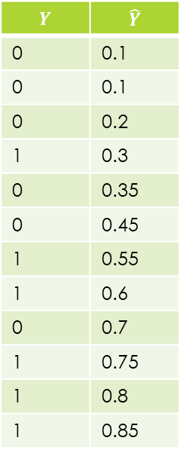
Model Calibration
$$Y$$ | $$\hat{Y}$$
0 | 0.1
0 | 0.1
0 | 0.2
1 | 0.3
0 | 0.35
0 | 0.45
1 | 0.55
1 | 0.6
0 | 0.7
1 | 0.75
1 | 0.8
1 | 0.85

Slide 7
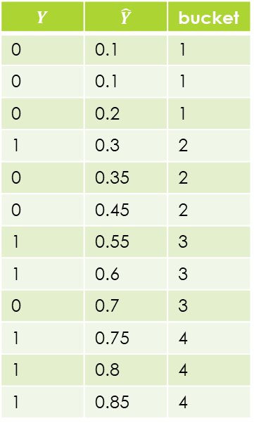
Model Calibration
$$Y$$ | $$\hat{Y}$$ | bucket
0 | 0.1 | 1
0 | 0.1 | 1
0 | 0.2 | 1
1 | 0.3 | 2
0 | 0.35 | 2
0 | 0.45 | 2
1 | 0.55 | 3
1 | 0.6 | 3
0 | 0.7 | 3
1 | 0.75 | 4
1 | 0.8 | 4
1 | 0.85 | 4

Slide 8
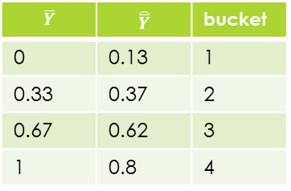
Model Calibration
$$Y$$ | $$\hat{Y}$$ | bucket
0 | 0.1 | 1
0 | 0.1 | 1
0 | 0.2 | 1
1 | 0.3 | 2
0 | 0.35 | 2
0 | 0.45 | 2
1 | 0.55 | 3
1 | 0.6 | 3
0 | 0.7 | 3
1 | 0.75 | 4
1 | 0.8 | 4
1 | 0.85 | 4
$$\overline{Y}$$ | $$\hat{\overline{Y}}$$ | bucket
0 | 0.13 | 1
0.33 | 0.37 | 2
0.67 | 0.62 | 3
1 | 0.8 | 4

Slide 9
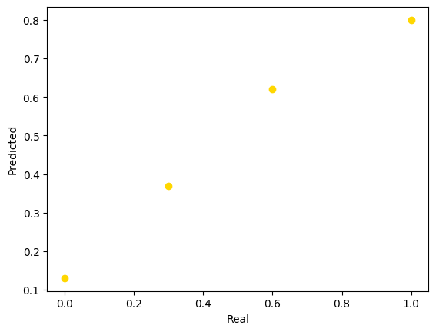
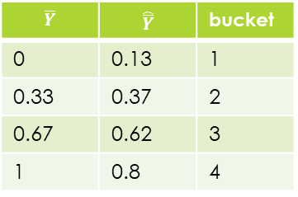
Model Calibration
$$\overline{Y}$$ | $$\hat{\overline{Y}}$$ | bucket
0 | 0.13 | 1
0.33 | 0.37 | 2
0.67 | 0.62 | 3
1 | 0.8 | 4

Slide 10
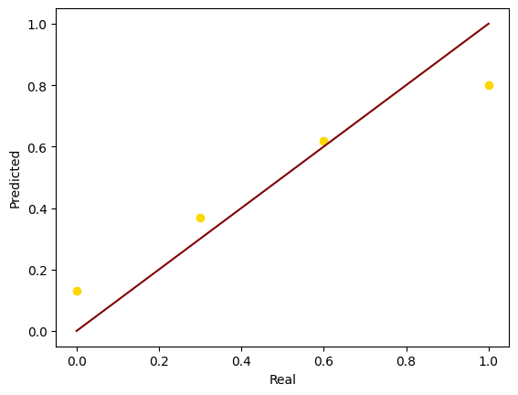
Model Calibration
$$\overline{Y}$$ | $$\hat{\overline{Y}}$$ | bucket
0 | 0.13 | 1
0.33 | 0.37 | 2
0.67 | 0.62 | 3
1 | 0.8 | 4

Slide 11
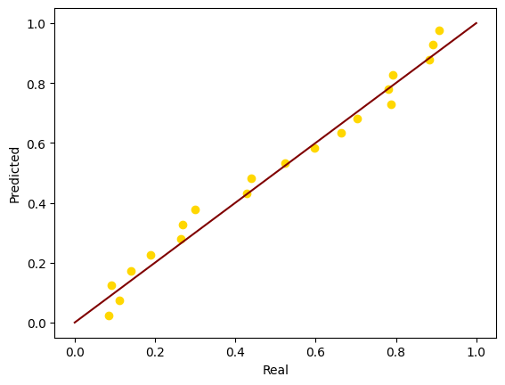
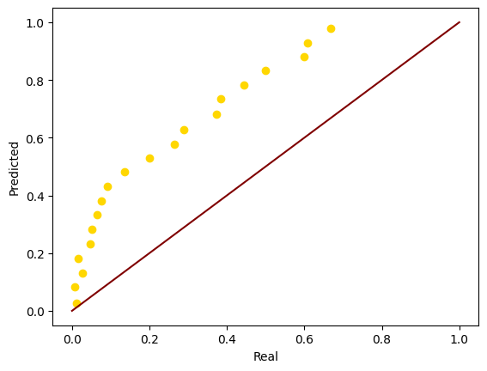
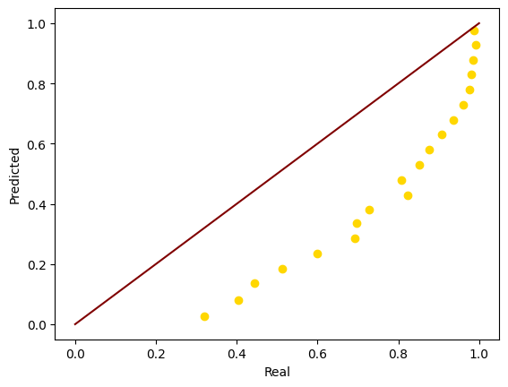
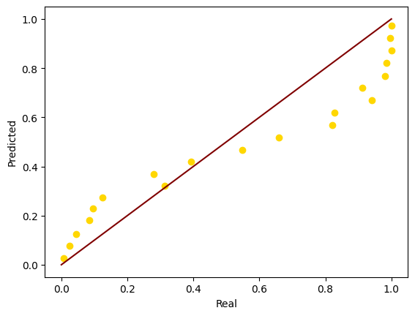
Calibrated
Biased towards class 1
Biased towards class 0
Overfitted

Slide 12
Biased towards class 1
Biased towards class 0
Overfitted
Notes:
Focal loss

Slide 13
Project idea- numer of models
Number of datasets
5
Imbalancing
Proportion
5
Balancing methods
4
Model architectures
3
360

Slide 14
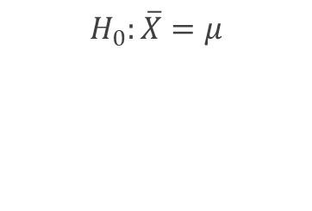
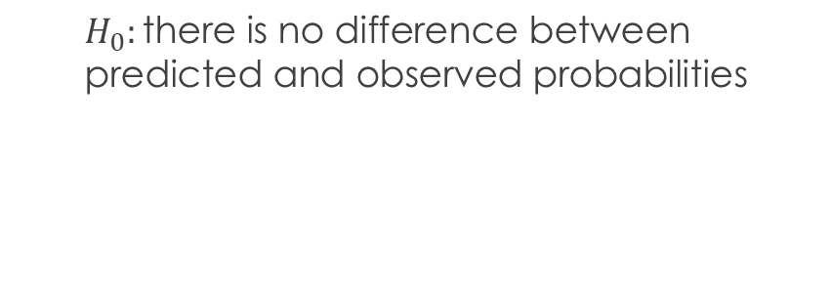
Measures of Calibration
Statistical tests
T-test
Wilcoxon- signed rank test
$$H_{0}:\overline{X}=μ$$
$$H_{0}:\text{there} \text{is} \text{no} \text{difference} \text{between} \text{predicted} \text{and} \text{observed} \text{probabilities}$$
Fit a model to bucketed probabilities and analyse its shape
MSE
Notes:
Irb strandards cite

Slide 15
XAI methods
Explanation
Global
Local
[Zhao et al., 2023] Zhao, H., Chen, H., Yang, F., Liu, N., Deng, H., Cai, H., Wang, S., Yin, D., and Du, M. (2023). Explainability for large language models: A survey.
Notes:
perturbation-based explanation is based on altering the input
sample by either removing, masking or altering input features and ex-
amining how those changes will affect the model’s prediction.
gradient-based explanation techniques determine the importance
of each input feature by analyzing the partial derivatives of the out-
put for each input dimension.
surrogate models are easily interpretable models like decision trees
and logistic regression that are trained to resemble black-box models.
decomposition-based methods- techniques that aim to break down the relevance score into linear contributions from the input.
attention-based explanation.
example-based explanations explain model behaviour for a given
input. They are mostly based on adversarial examples, counterfac-
tual explanations, and data influence
natural language explanation- use of LLM to explain their thought
process.

Slide 16
XAI methods
Explanation
Perturbation-based
Example-based
Gradient-based
Attention-based
Surrogate models
Natural language explanation
Decomposition-based
Notes:
perturbation-based explanation is based on altering the input
sample by either removing, masking or altering input features and ex-
amining how those changes will affect the model’s prediction.
gradient-based explanation techniques determine the importance
of each input feature by analyzing the partial derivatives of the out-
put for each input dimension.
surrogate models are easily interpretable models like decision trees
and logistic regression that are trained to resemble black-box models.
decomposition-based methods- techniques that aim to break down the relevance score into linear contributions from the input.
attention-based explanation.
example-based explanations explain model behaviour for a given
input. They are mostly based on adversarial examples, counterfac-
tual explanations, and data influence
natural language explanation- use of LLM to explain their thought
process.

Slide 17
XAI- Perturbation-based
The elusive fireflies danced among the whispering trees, casting their ethereal glow upon the tranquil night
The fireflies ↔ elusive danced among the whispering trees, casting their ethereal glow upon the tranquil night
The elusive fireflies danced among the whispering trees, casting their ethereal glow upon the tranquil night
The elusive firefliesflies danced among the whispering trees, casting their ethereal glow upon the tranquil night
Notes:
perturbation-based explanation is based on altering the input
sample by either removing, masking or altering input features and ex-
amining how those changes will affect the model’s prediction.
gradient-based explanation techniques determine the importance
of each input feature by analyzing the partial derivatives of the out-
put for each input dimension.
surrogate models are easily interpretable models like decision trees
and logistic regression that are trained to resemble black-box models.
decomposition-based methods- techniques that aim to break down the relevance score into linear contributions from the input.
attention-based explanation.
example-based explanations explain model behaviour for a given
input. They are mostly based on adversarial examples, counterfac-
tual explanations, and data influence
natural language explanation- use of LLM to explain their thought
process.

Slide 18
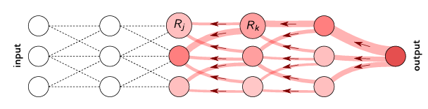
XAI- Gradient-based
Notes:
gradient-based explanation techniques determine the importance
of each input feature by analyzing the partial derivatives of the out-
put for each input dimension.

Slide 19
XAI- Surrogate models
Logistic regression
Notes:
surrogate models are easily interpretable models like decision trees
and logistic regression that are trained to resemble black-box models.

Slide 20
XAI- Decomposition-based
Ein = Eout
Notes:
decomposition-based methods- techniques that aim to break down the relevance score into linear contributions from the input.
conservation of energy
Robustness to Non-differentiable Activation Functions: Gradient-based methods rely on calculating gradients of the model's output with respect to its input. However, if the model contains non-differentiable activation functions (e.g., ReLU), gradients may not be well-defined at certain points, leading to difficulties in interpretation. Decomposition-based methods like LRP do not rely on gradients and can handle non-differentiable activation functions more effectively.
Layer-wise Interpretability: Decomposition-based methods often provide layer-wise explanations, allowing users to understand the contribution of each layer of the neural network to the final prediction. This can offer a more intuitive understanding of how the model processes information and makes decisions, which may be lacking in gradient-based methods.

Slide 21
XAI- Attention-based
[Jain and Wallace, 2019] Jain, S. and Wallace, B. C. (2019).
Attention is not explanation
[Wiegreffe and Pinter, 2019] Wiegreffe, S. and Pinter, Y. (2019).
Attention is not not explanation.
Notes:
Attention is a mechanism that calculates the most relevant part of inputs.

Slide 22



XAI- Example-based
I loved the movie → I didn't love the movie
Training sample
Training sample
Notes:
example-based explanations explain model behaviour for a given
input. They are mostly based on adversarial examples, counterfac-
tual explanations, and data influence

Slide 23
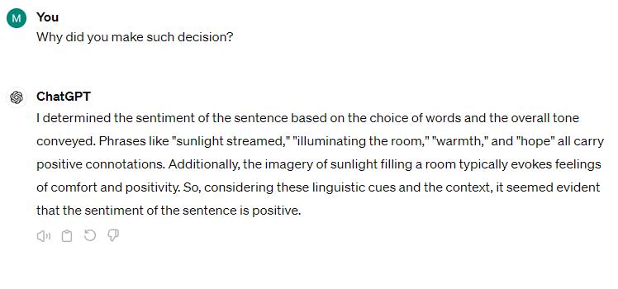
XAI- Natural language explanation
Notes:
natural language explanation- use of LLM to explain their thought
process.

Slide 24

XAI methods
Gradient based methods
Decomposition based methods
Vanilla gradient- based method
Layer- wise relevance propagation
Notes:
Integrated Gradients provides an attribution score for each feature in the input data, indicating how much each feature contributes to the model's prediction for a particular instance. By attributing contributions to each feature, it helps in understanding which features are influential in driving the model's decision locally for a given input.
LRP(Layer-Wise Relevance Propagation) [Montavon et al., 2019]-
it operates by propagating the
prediction backwards through the neural network. This procedure has a
conservation property (total charge entering a junction is equal to he total
charge leaving the junction).

Slide 25
XAI methodology
 | What | is | model | calibration | and | why | it | is | important
XAI | 0.1 | 0.2 | 0.6 | 0.8 | 0.05 | -0.2 | 0.1 | 0.2 | -0.4

Slide 26
XAI methodology
 | What | is | model | calibration | and | why | it | is | important
Model1 | 0.1 | 0.2 | 0.6 | 0.8 | 0.05 | -0.2 | 0.1 | 0.2 | -0.4
Model2 | 0.1 | 0.3 | 0.7 | 0.85 | 0.02 | -0.3 | 0.2 | 0.1 | -0.45

Slide 27
XAI methodology
 | What | is | model | calibration | and | why | it | is | important
Model1 | 0.1 | 0.2 | 0.6 | 0.8 | 0.05 | -0.2 | 0.1 | 0.2 | -0.4
Model2 | 0.1 | 0.3 | 0.7 | 0.85 | 0.02 | -0.3 | 0.2 | 0.1 | -0.45
p-value

Slide 28
Libraries
DeepExplain (LRP)
Transformers(BERT)
SHAP (Gradient based XAI)
OpenAI GPT
SciPy (t-test, wilcoxon-signed rank test)

